Slide 1


40h(Mad, 3000rpm, unfiltered, 120deg substrate, 5minutes soak in water)
x5
x10

Slide 2

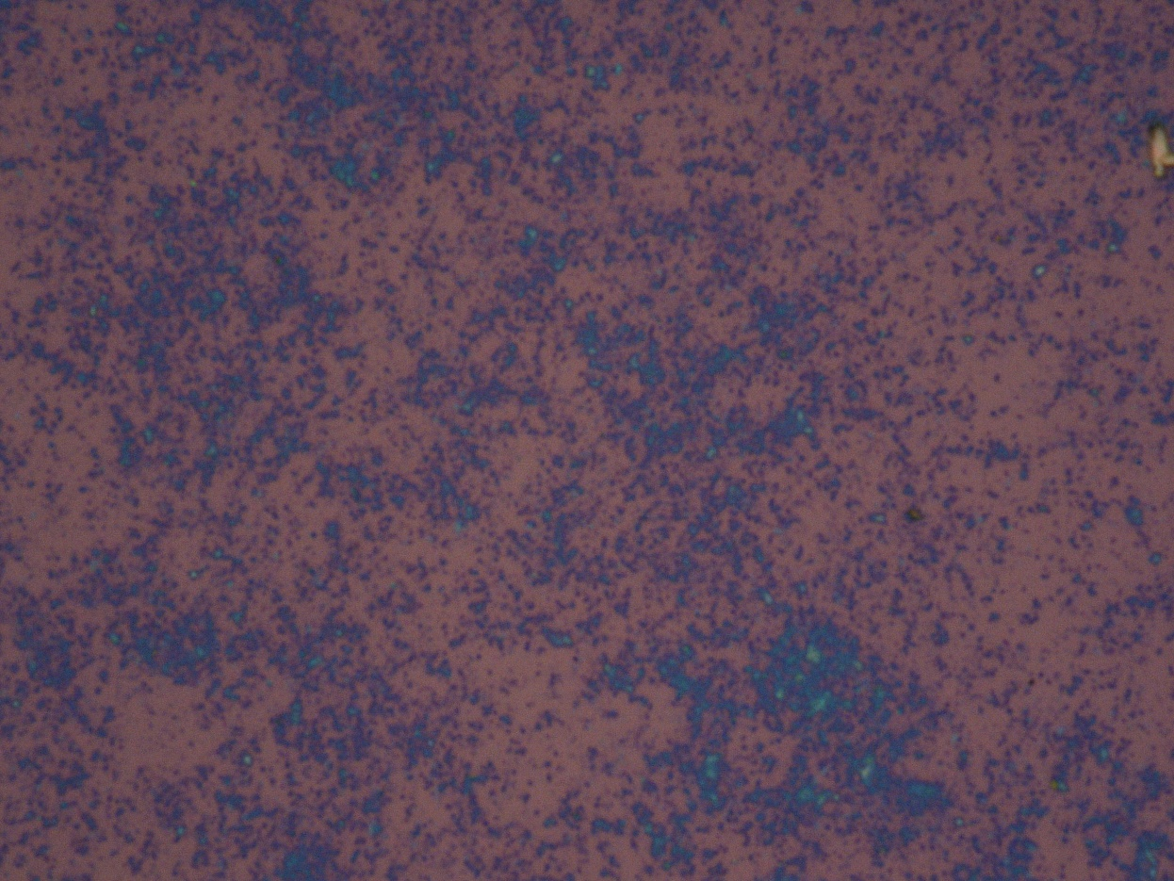
x50
x100

Slide 3
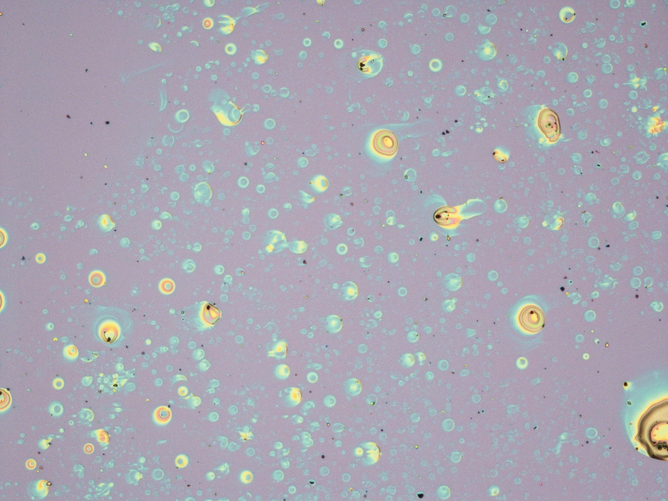
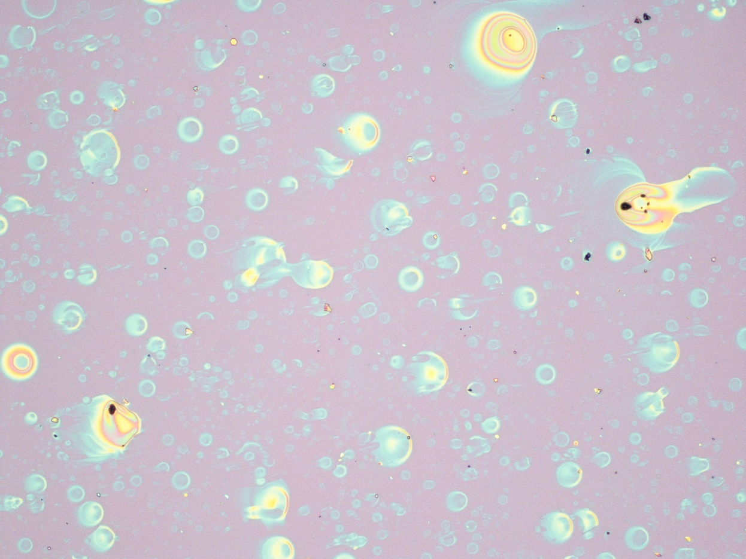
40h(Mad, 4000rpm, 120deg substrate)
x5
x10

Slide 4
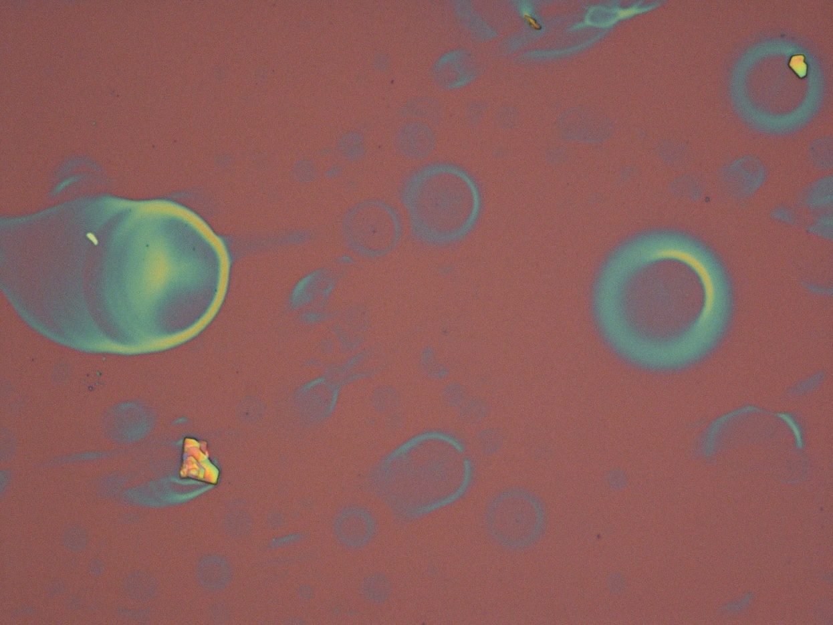
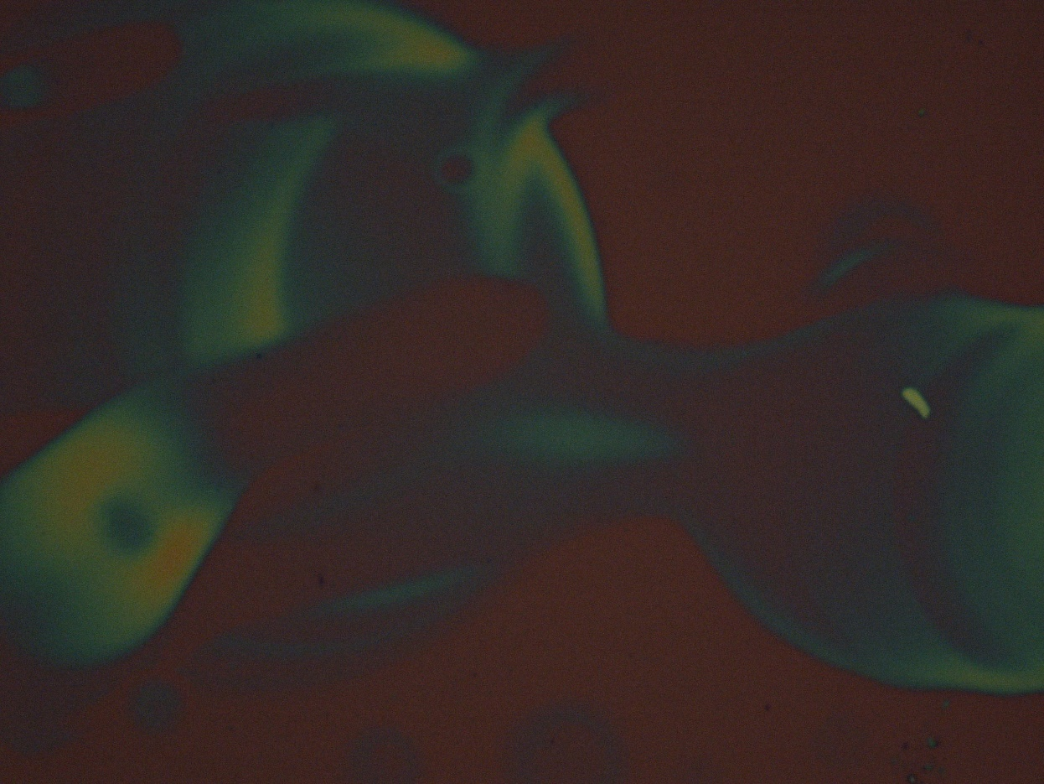
x50
x100

Slide 5
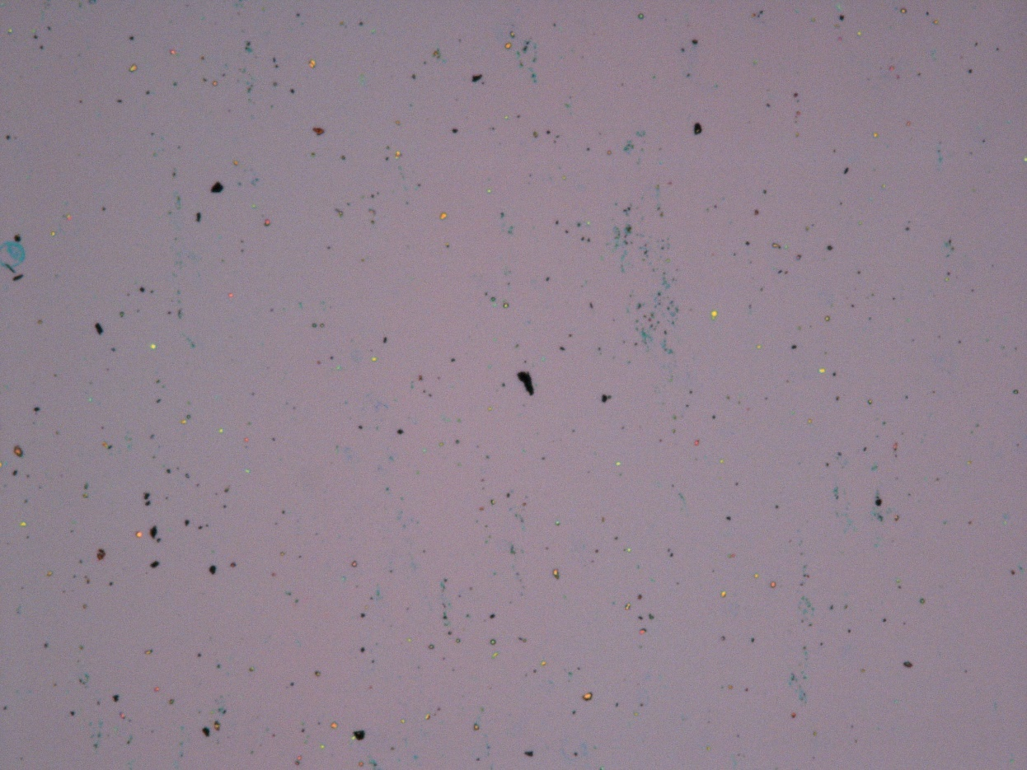
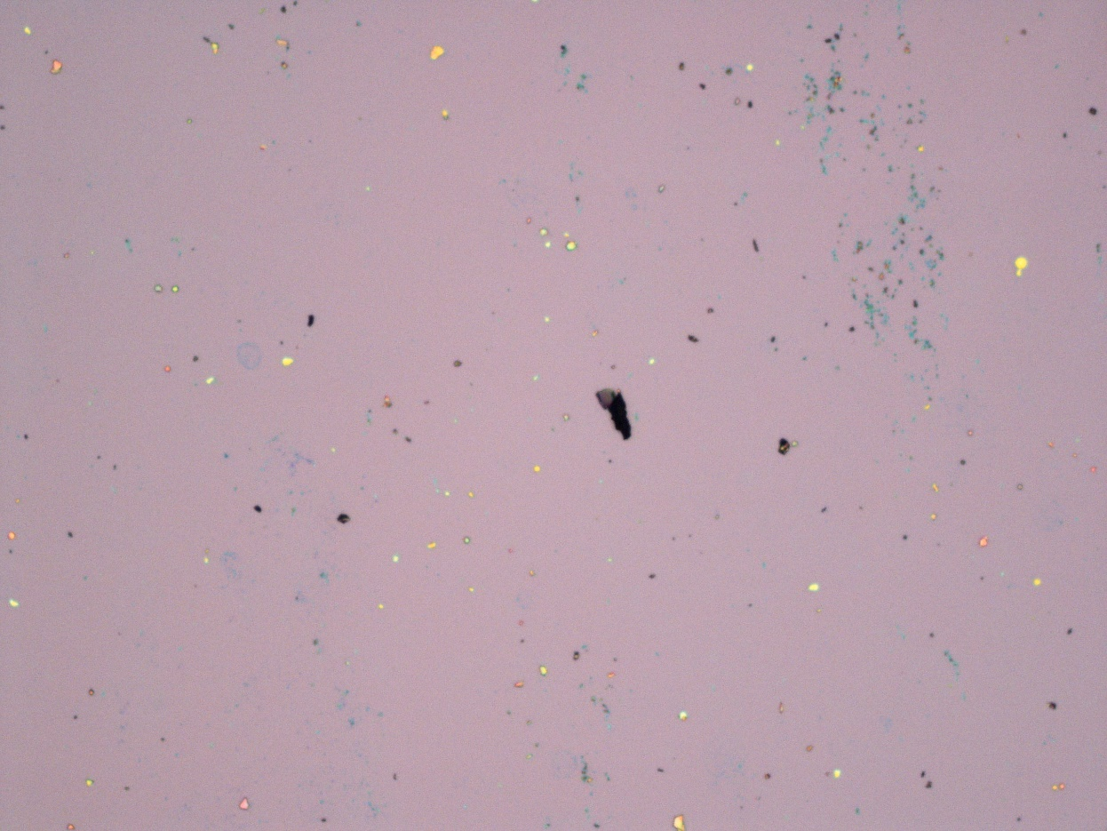
50h(Mad, 2500rpm, 120deg substrate, soak in water for 5 min)
x5
x10

Slide 6
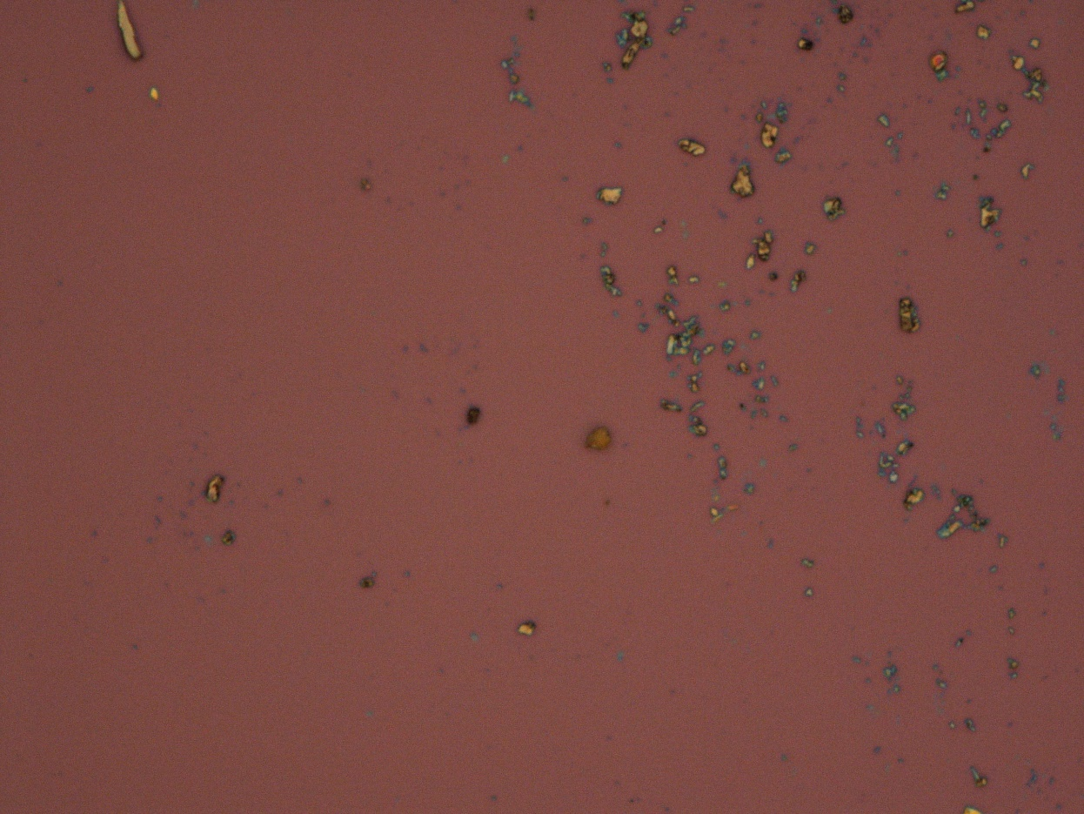
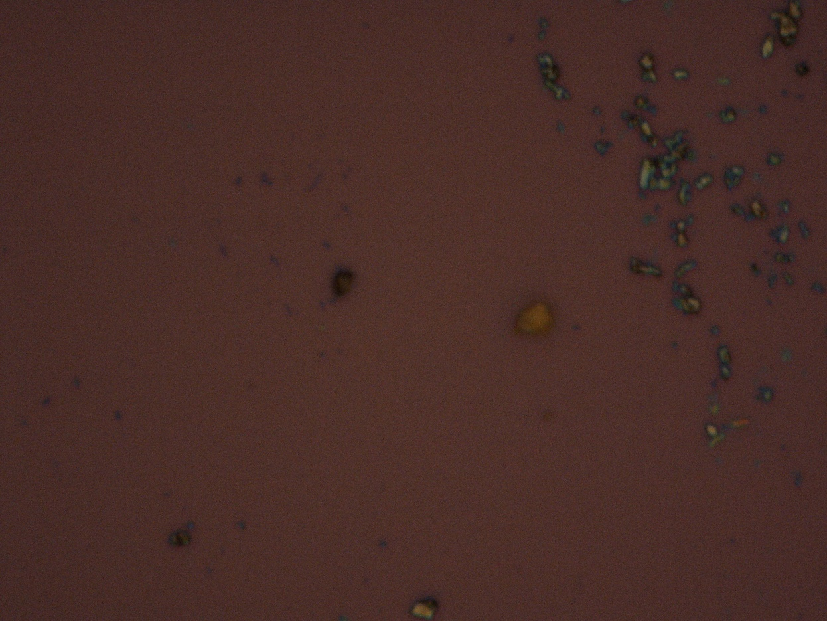
x5
x100

